Slide 1
On the All-Farthest-Segments problem for a planar set of points
Asish Mukhopadhyay , Samidh Chatterjee, Benjamin Lafreniere
Information Processing Letters 100 (2006) 120–123
accepted 22 June 2006
Speaker: Chun-Jen Chen
Date: Mar. 5, 2008

Slide 2
Abstract
In this note, we outline a very simple algorithm for the following problem:
Given a set S of n points p₁,p₂,p₃, . . . , p_{n} in the plane, we have O(n²) segments implicitly defined on pairs of these n points. For each point p_{i} , find a segment from this set of implicitly defined segments that is farthest from pi .
The time complexity of our algorithm is in O(nh + n log n), where n is the number of input points, and h is the number of vertices on the convex hull of S.

Slide 3

All-Farthest-Segments problem
115/11/07

Slide 4
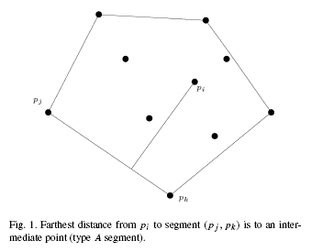
All-Farthest-Segments problem
115/11/07

Slide 5
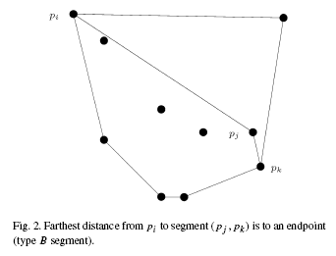
All-Farthest-Segments problem
115/11/07

Slide 6
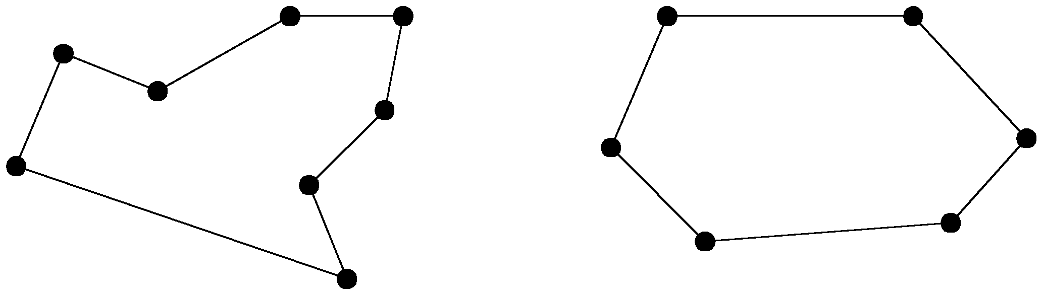
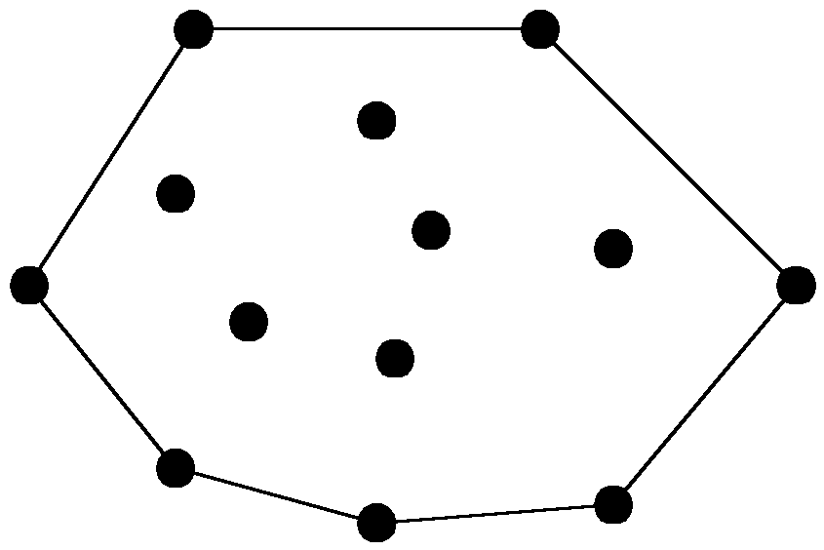
The convex hull problem
concave polygon:
convex polygon:
The convex hull of a set of planar points is the smallest convex polygon containing all of the points.
115/11/07

Slide 7

Lemma 1.
115/11/07

Slide 8
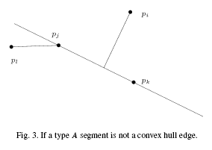
Lemma 1.
115/11/07

Slide 9


Lemma 2.
115/11/07

Slide 10
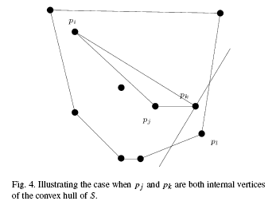
Lemma 2.
115/11/07

Slide 11
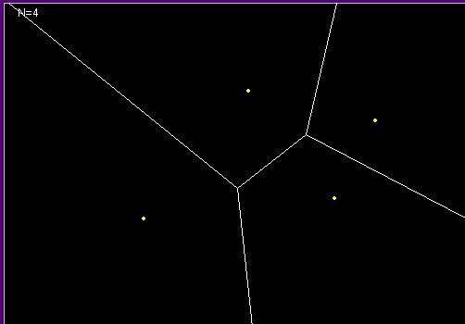
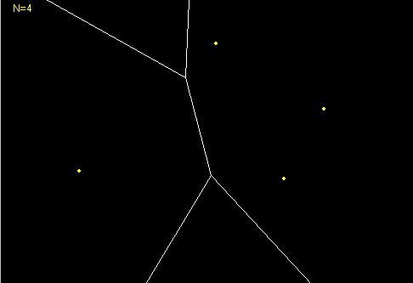
Voronoi
Voronoi Farthest-point Voronoi
115/11/07

Slide 12
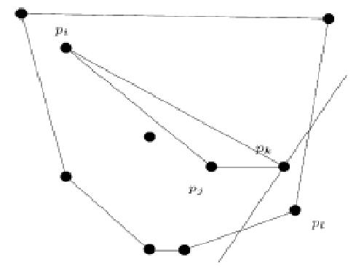
Algorithm
115/11/07

Slide 13
Analysis
Step 1: O( h )
Step 2: O( log( n-h ) )
Step 3: O( h )
115/11/07

